Slide 1

DS 210 : Intro to Data Science Final Project
Robert Daniels, Spring 2022

Slide 2
Introduction and Stating the Question
Challenge
Perform exploratory data analysis
Sanitize data inputs, if needed
Attempt to build a linear regression model in KNIME
Test this model for reliability
Goal
Can we predict the outside temperature based on the frequency of cricket chirps?

Slide 3

The Data Set

Slide 4
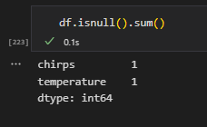
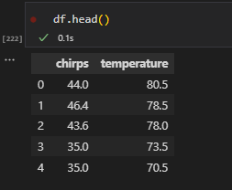
Initial Findings
The raw .csv file contains 58 records of type float, with a shape of (59,2) including the attribute labels
Chirps: cricket chirp frequency (per 15 seconds)
Temperature: Fahrenheit
Each attribute contains 1 record with a null value

Slide 5
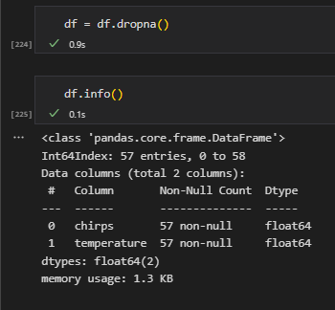
Data Analysis : The messy null
In this case, the null values represent a small portion of the data set.
Thus, we can safely remove the 2 records in question.

Slide 6
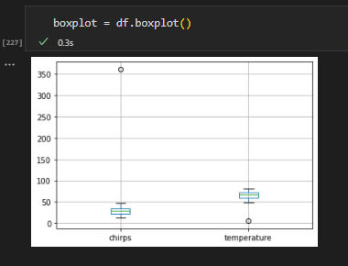
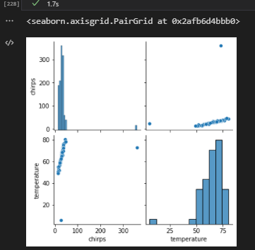
Data Analysis: Outliers
Outliers are visually evident in the data set. That won’t do!

Slide 7
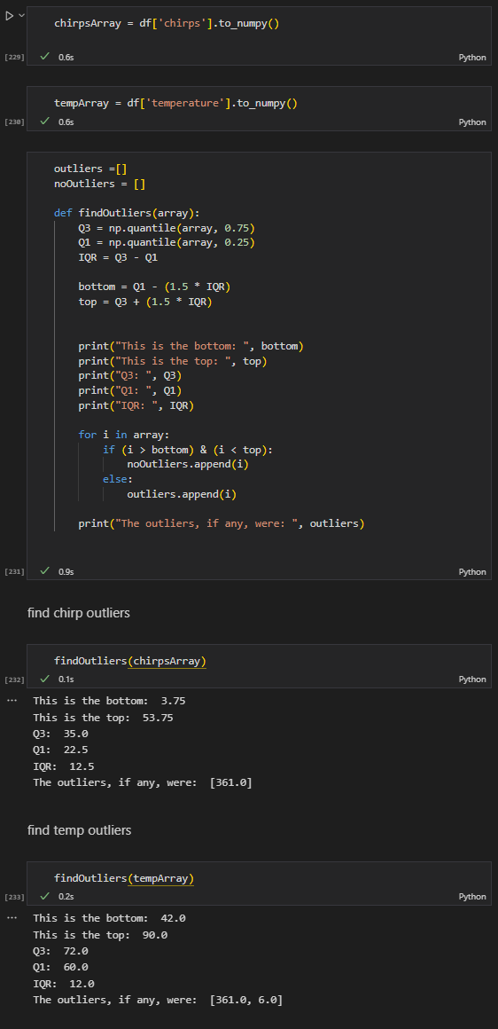
Data Analysis : Outliers
Outliers are clearly skewing the data set
Solution: apply statistical reasoning to find the outliers in question

Slide 8
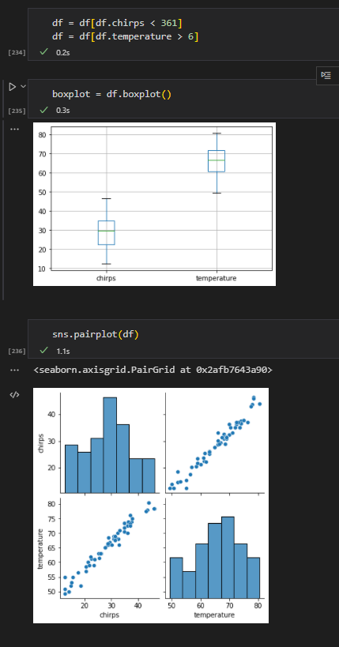
Data Analysis: Outliers
Mask out the outliers from the data set
Much better!
A linear relationship emerges from the data

Slide 9
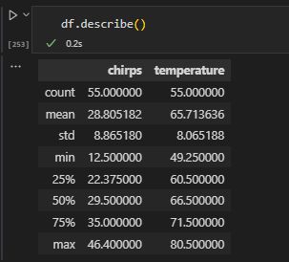
Data Analysis: General Statistics

Slide 10
Refining the question: Any reason to change our goal?
Recall
Our goal was to see if there was a strong correlation between chirp frequency and temperature
Visualize
Visually, a strong linear trend can be seen between these two attributes
Build
Next step: Use KNIME to build a model

Slide 11
Model Building: KNIME
Using the KNIME platform, we can build a linear regression model based on the data set.
Linear Regression is a supervised learning method.
We provide the computer with a subset of known data
Let the computer build a model off said data
Verify the model with another subset of known data

Slide 12
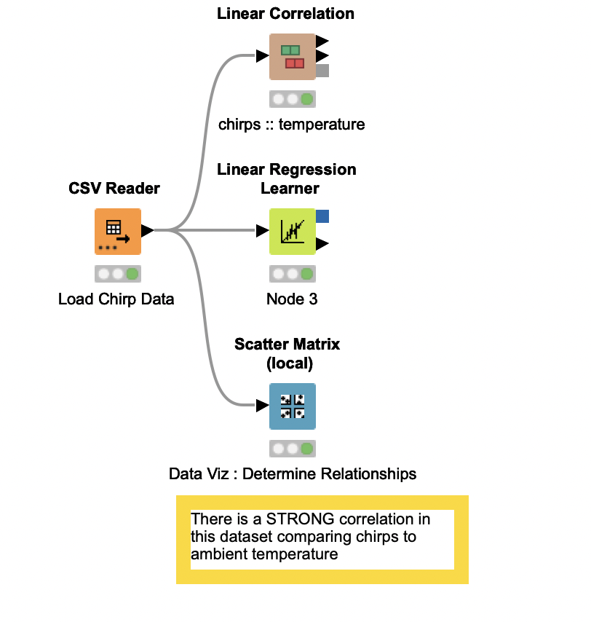
KNIME: Workflow
The data are loaded via the CSV reader.
From this point, a scatter matrix can be generated for visualization
Basic linear correlation and a linear regression learner can be run on the frame

Slide 13
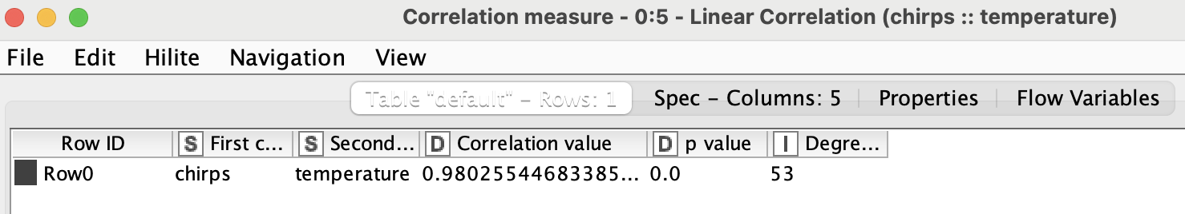

KNIME: Correlation coefficient and Statistics
Post processing, the correlation is STRONG, with a correlation value of .98
This value ranges from 0 to 1, roughly meaning that 98% of the variance in the dependent variable can be explained by a variance in the independent variable

Slide 14
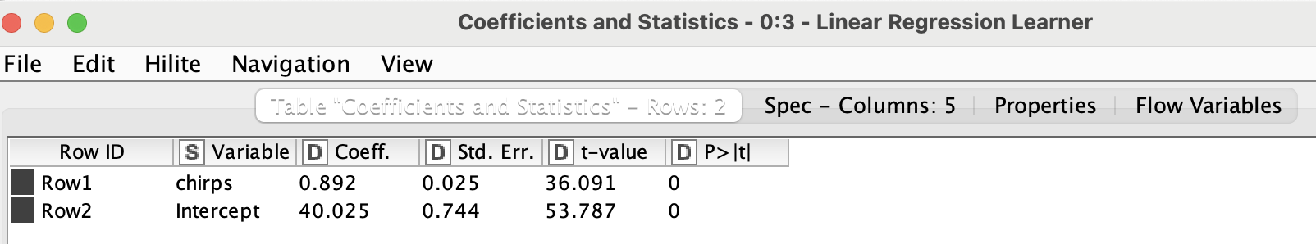
KNIME: Correlation coefficient and Statistics
To find temperature as a function of chirps (temp(chirps)):
temperature(y) = .892(chirps) + 40.025

Slide 15
KNIME: Regression Line
What is it: the line of best fit
You are trying to find a line that, when drawn, has the least amount of sum squared distance between each point to the line
Why squared? Because some points are expected to be under, and some over.
Squaring each value eliminates the cancel out
This would be time consuming to do by hand!
Thankfully, computers are made for this type of thing
Y = mx + b
X (slope)
b(y intercept)

Slide 16

KNIME: Prediction : 40 chirps
temperature(y) = .892(chirps) + 40.025
Temperature = .892(40) + 40.025
Predicted Temperature = 75.705 degrees

Slide 17
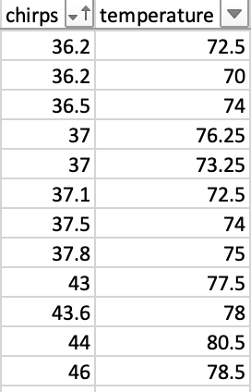
Reasonableness check! Important!
The model is predicting at 40 chirps, we’d expect to see a temperature around 75.7 degrees. Given our known data points, this is in line with expectations

Slide 18

Interpretation
Given what we’ve covered, we have a reasonable basis to conclude we CAN predict outside temperature based on chirp frequency

Slide 19
Next Steps
Gather
Gather more data and test the model further
Check
Check for confounding factors: humidity, time of day, time of year
Explore
Explore business test cases

Slide 20
Recap:
We formed our initial question
Can we estimate outside temperature based on chirp frequency?
Explored our data set
Scrubbed our product for processing
Fed our model the data set in KNIME
Validated our data set
Interpreted and came to a conclusion based off the model results
Determined null values
Determined outliers present
Removed null values
Discarded outliers
Using the regression formula generated by the model
Based off these data, ambient temperature CAN be estimated based off chirp frequency

